Slide 1
Sri Ponnada
Software Engineer, Microsoft
Notes:
Hi everyone, I’m Sri Ponnada - I work at Microsoft as a Software Engineer and today I’m here to talk to you all about Community Centered Tech for Social Good.
Before I get started - I have a question.
How many of you have a problem that keeps you up at night?
(wow that’s a lot of people / wow you guys must have great lives)
Okay - how many of you have a technology problem that keeps you up at night?
During my speaker interview with Wes, he asked what technology problem keeps me up at night - I realized - it’s technology. Technology itself is the problem.

Slide 2

The existing divides are not merely infrastructural - they are increasingly knowledge and culture based.
Notes:
Rapid advancements in technology have led to the rise of what’s known as the “digital divide”.
When I say “digital divide” what I’m really talking about is the laaaarge number of gaps that exist in the access and usage of information and communication technology.
The more that the internet becomes the medium for business, for education, for social services, professional development, and even social interaction, it becomes that much more necessary for members of today’s society to have the educational and cultural background to really utilize it.
It’s like we’ve created this whole new world that exists online, and unfortunately, many individuals - especially from low income neighborhoods - and organizations like nonprofits and small government agencies in the real world are being left behind.
Heck, I work in the tech industry - at Microsoft - and even I feel like I’m being left behind!

Slide 3
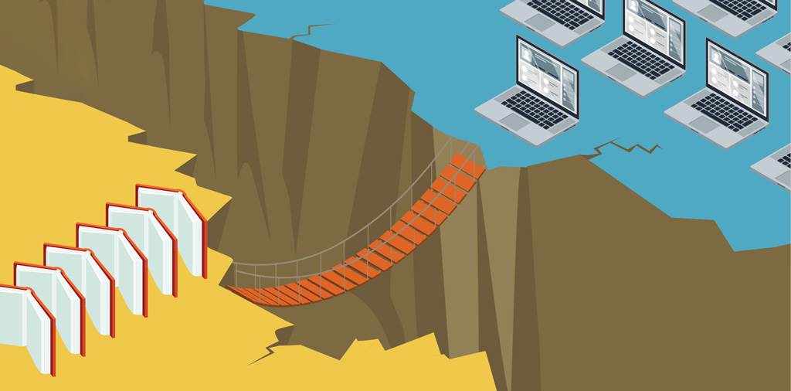
Bridging the gap
Notes:
So in this talk, we’re going to explore the “digital divide” - how it affects our society, our industry - and how we might overcome it before technology pushes us further apart from one another.
Before we jump into things, I’m gonna take a little detour and tell you more about myself.
Although my day job is Software Engineer - my educational background is in English, and Gender, Women’s Sexuality Studies. While many of my peers (and maybe people in this room) were writing code in college, I was writing scripts for my radio show.
For an entire year, I didn’t even have access to a computer - my only access to the internet was through a mobile device.

Slide 4
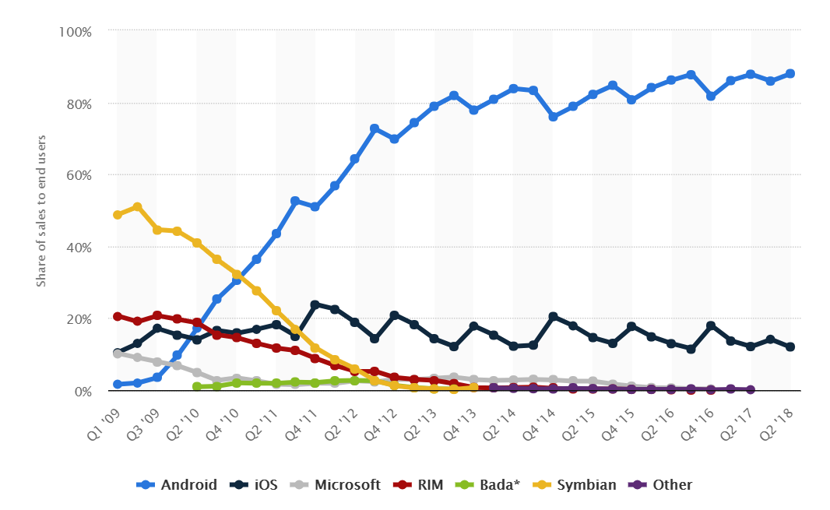
Global mobile OS market share in sales to end users from 1st quarter 2009 to 2nd quarter 2018
Notes:
Even though that might sound a little crazy to some of the folks in this room - most of the people in the world access the internet through a mobile device nowadays, especially with how affordable smartphones and tablets have become compared to what they once were.
In fact, most people - even in America - particularly in low income households are more likely to have a smartphone or tablet vs. a computer. Unbelievable! I was actually reading a great article in The Atlantic called “It’s Not Only Rich Teens That Have Smartphones” that goes into detail about this.
I’m not going to bore you with all the details but TLDR is that a striking 85 percent of families living below the poverty line have some kind of digital device, smartphone or tablet, in their household. Seventy-three percent had one or more smartphones.
Looking back, I think my personal interest in mobile development - which is how I started my career in software engineering sparked because of my own background and comfort using those devices.
My first hardcore engineering class was actually on iOS Development, and at my first job out of college I was building Android apps. I want to point out - just because I’ve heard quite a few people complain about Android and wonder why we even make Android apps anyway - Android phones are especially popular in developing countries because of the price point compared to iOS.
In fact, most of the world runs on Android. Statistics from Business Insider show that as of November 2017, iOS has lost its market share even in the United States, Europe, and Japan.

Slide 5
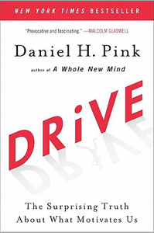
The three elements of motivation:
1. Autonomy
2. Mastery
3. Purpose
Notes:
So, back to my story - part of me was drawn to mobile dev because the web - as silly as it sounds now - was a scary place for me. I wasn’t used to it. I didn’t understand how it worked.
Somehow, when I managed to get to Microsoft , I ended up as a web dev for the first time.
Talk about how it had always been my dream to work at Microsoft.
But something was missing. (talk about that feeling) I didn’t feel like I had a purpose and I was feeling lost a lot of the time. It pained me to realize that even though I was at my dream job -- I wasn’t happy.
Daniel Pink actually talks about this in his book, “Drive: The Surprising Truth About What Motivates Us”. He examines the three elements of motivation: autonomy, mastery, and the last one was what stood out to me the most –
Purpose.
Purpose is one of the three ingredients to high performance and satisfaction— at school, at home, and at your job
Now, while I was having my existential crisis - Hackathon was just around the corner. So to get my mind feeling a little better, I decided to do a project. I had heard about the Hack 4 Good category when I started at Microsoft, so I was really excited! 1. Because I wanted to work with a nonprofit and see how I could help out with my skills, and 2. Because I heard a rumor that if you did a project in this category, Satya Nadella would come by and shake your hand. Anyway, I ended up doing a project in partnership with the City of Seattle, and Seattle Parks Foundation.

Slide 6
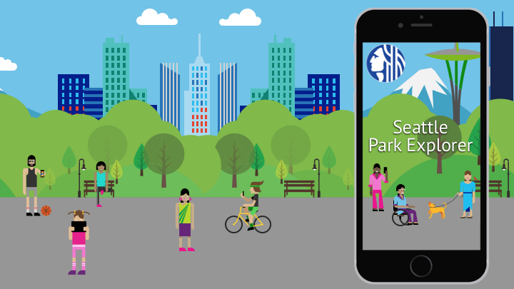
Notes:
I don’t know how many of you are from Seattle but we got a lot of parks up there! The Seattle Parks & Recreation Department manages over 6,000 acres of parks and recreation areas!
I’ve been to quite a few of the and fell in love with Seattle’s natural beauty. Not only that, but when I started digging into background about the Parks & Recreation Department, I was delighted by their mission : healthy people, healthy environment, strong communities. The Parks Foundation takes it even further. I was really inspired by their core commitments to:
Service and collaboration
Learning and innovation
Diversity, equity, and inclusion
I wanted to do something to help.
So, I contacted the two organizations. They told me they were excited but didn’t have tech chops - and that’s when the digital divide in my own community became that much more apparent.

Slide 7
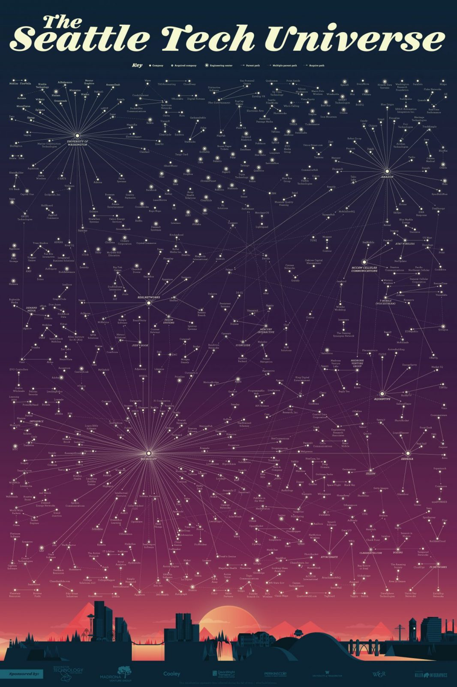
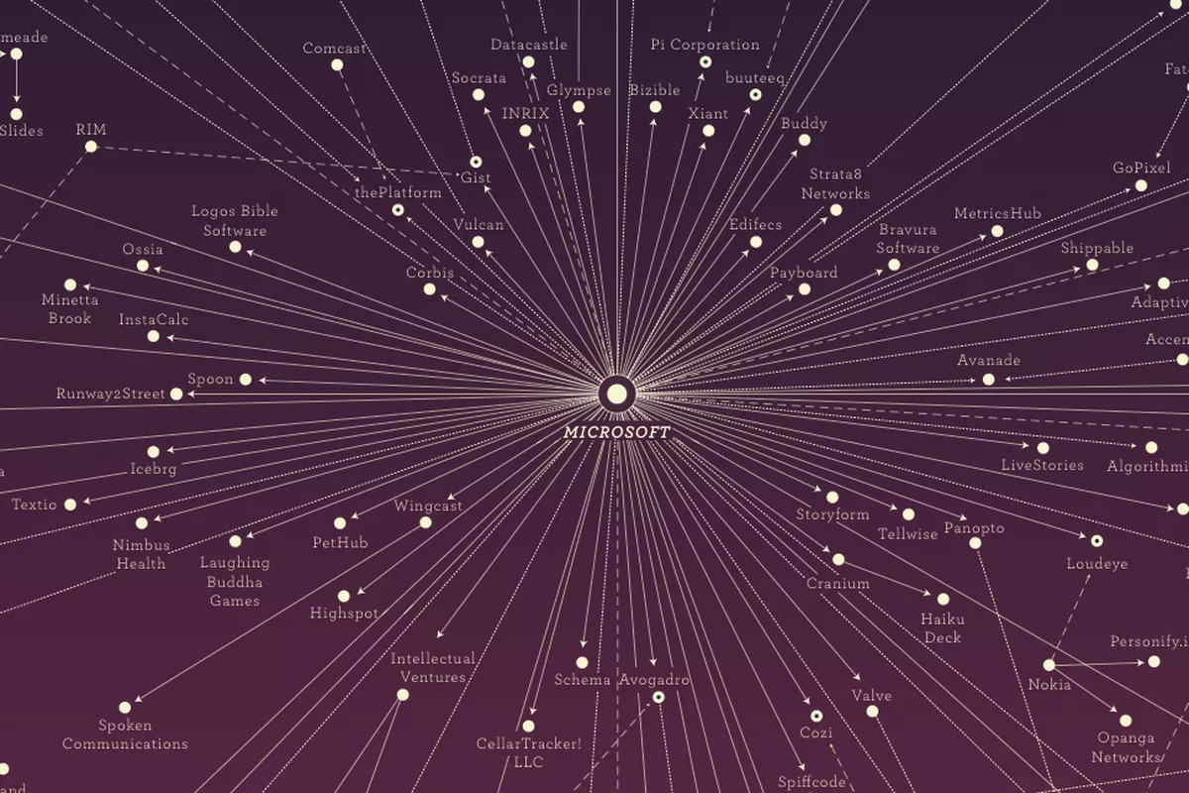
Developed by Madrona Venture Group, WTIA
Over 600 startups
More software developers than any other metro area, including SF
Notes:
This is a map of Seattle’s tech ecosystem put together by Madrona Venture Group and the Washington Technology Industry Association. [ look back at map ]
There’s a lot of nodes on that graph. I think the biggest one is actually Microsoft. But can you believe it’s from 2015? Imagine how much larger today’s map would be! How is it possible that the city has such antiquated technology / no support.
I wanted to use my privilege to change that. And the hackathon was the perfect opportunity to do so.

Slide 8
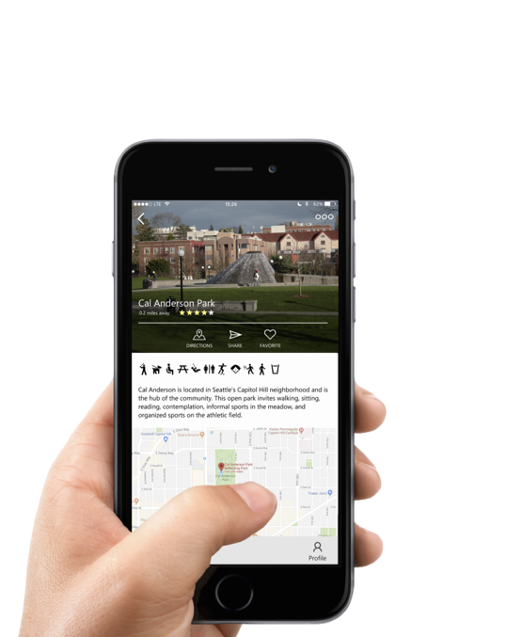
Residents can find nearest park with an available / certain amenity
City can have access to data on how parks and amenities are being utilized
Members of the community can engage with one another in public spaces
Notes:
So we built a fully functional app in two days. Talk about the app itself and the vision behind the app.
I know there’s probably someone out there who thinks Yelp, Google or something else already exists to do the job BUT:
1. Why is the idea of software development volunteering so foreign? I’ve never been able to understand that.
2. City is not happy with Google mining their data and incorrectly displaying it because that’s more work for them to have to go through the various business profiles and clean them up and
CITY LOST ITS VOICE
3. Google is the one who owns the data of how people are interacting with the parks - not the city. But the app could change that
Reemphasize how we bridged a digital divide in my community and while doing that I realized I gained a sense of purpose. Not only that, but also mastery and autonomy talk about Loren and how his experience (14 years) in software was critical to me and my growth + success
DANIEL PINK AUTONOMY, MASTERY, PURPOSE

Slide 9
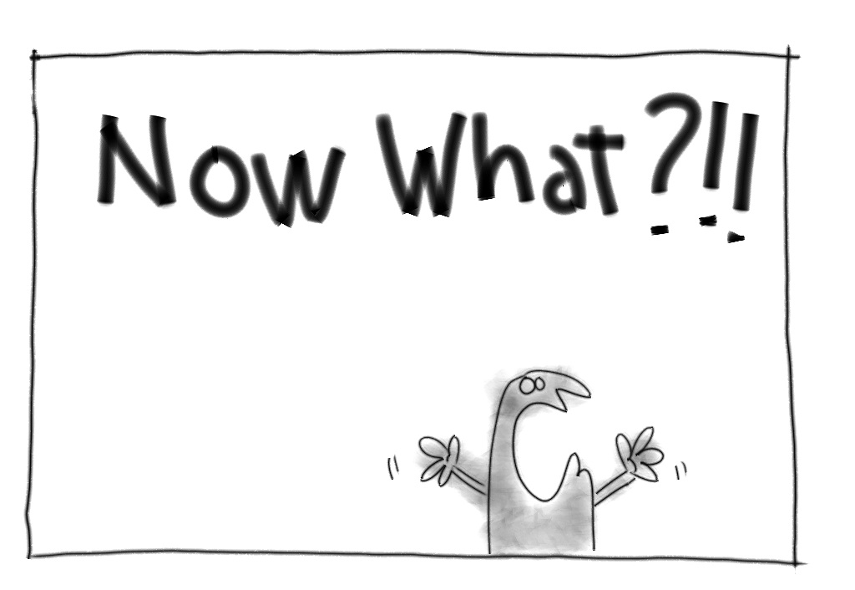
Notes:
So what is the takeaway for you?
You can gain sense of purpose by doing projects like this
Seasoned devs and managers can help younger generation of developers grow in their craft
You can help bridge the divide in our industry by retaining diverse talent who will then have a ripple effect because they’ll continue to do good work as they grow and attract more diverse individuals to our industry
You don’t have to build the next Uber or Snapchat or Facebook. You just have to build something that actually creates an impact. One of my first memories of technology is playing snake on a Nokia phone that didn’t even have color - it didn’t matter that the game already existed - it sparked my interest in mobile development. It changed my life.
It doesn’t matter if what you build only impacts one person’s life - it’s still a life that you have changed. But that can’t happen unless you go out there and do something. You could help revamp an app for the local library system or an app to help parents of kids with special needs track their kids schedules.
And it doesn’t always have to be building something. You could volunteer with an organization that supports stem education for underrepresented groups as a mentor or teacher, or you could just play more of an advisory role for a local organization because you’d be surprised how desperate they are for any kind of tech help

Slide 10
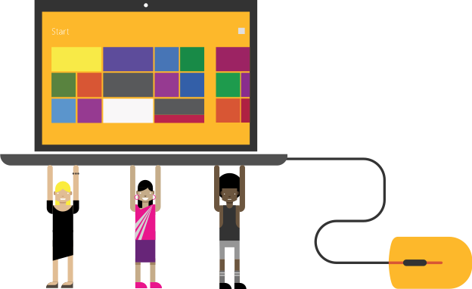
Digital Inclusion
Notes:
So I ask again, why not actually use our software superpowers to address the larger digital divide in our society. If each of us pitches in to do our part, I really believe that together, we can transform our society from one plagued by digital divides to one empowered by digital inclusion.

